Slide 1
Chapter 12-Parallel and serial transmission

Slide 2
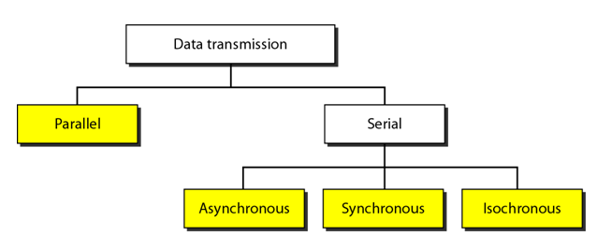
Introduction
The transmission of binary data across a link can be accomplished in either parallel or serial mode. In parallel mode, multiple bits are sent with each clock tick. In serial mode, 1 bit is sent with each clock tick. While there is only one way to send parallel data, there are three subclasses of serial transmission: asynchronous, synchronous, and isochronous.

Slide 3
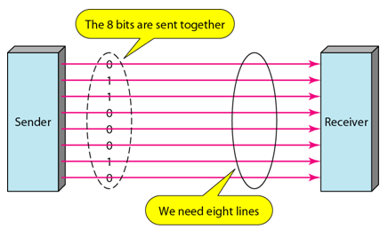
Parallel Transmission
Binary data, consisting of 1s and 0s, may be organized into groups of n bits each. By grouping we can send data n bits at a time instead of one. This is called parallel transmission.
The mechanism of parallel transmission is conceptually simple: use n wires to send n bits at a time. That way each bit has its own wire, and all n bits of one group can be transmitted with each clock pulse from one device to another.
Typically, the eight wires are bundled in a cable with a connector at each end.

Slide 4
Parallel Transmission
The advantage of parallel transmission is speed. All else being equal, parallel transmission can increase the transfer speed by a factor of n over serial transmission.
But there is a significant disadvantage: cost. Parallel transmission requires n communication lines (wires in the example) just to transmit the data stream. Because this is expensive, parallel transmission is usually limited to short distances.

Slide 5
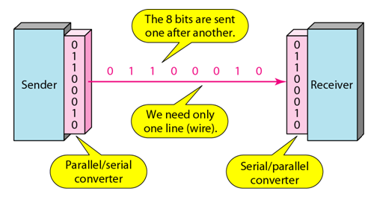
Serial Transmission
In serial transmission one bit follows another, so we need only one communication channel rather than n to transmit data between two communicating devices.
The advantage of serial over parallel transmission is that with only one communication channel, serial transmission reduces the cost of transmission over parallel by roughly a factor of n.
Since communication within devices is parallel, conversion devices are required at the interface between the sender and the line (parallel-to-serial) and between the line and the receiver (serial-to parallel).

Slide 6
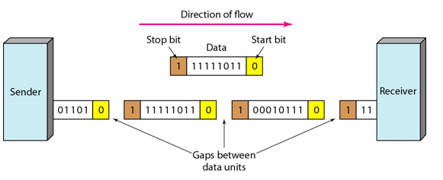
Asynchronous Transmission
Asynchronous transmission is so named because the timing of a signal is unimportant.
Instead, information is received and translated by agreed upon patterns.
As long as those patterns are followed, the receiving device can retrieve the information without regard to the rhythm in which it is sent.

Slide 7
Asynchronous Transmission
Patterns are based on grouping the bit stream into bytes. Each group, usually 8 bits, is sent along the link as a unit.
The sending system handles each group independently, relaying it to the link whenever ready, without regard to a timer.
In asynchronous transmission, we send 1 start bit (0) at the beginning and 1 or more stop bits (1s) at the end of each byte.
In addition, the transmission of each byte may then be followed by a gap of varying duration. This gap can be represented either by an idle channel or by a stream of additional stop bits.

Slide 8
Asynchronous Transmission
The start and the stop bits and the gap alert the receiver to the beginning and end of each byte and allow it to synchronize with the data stream. This mechanism is called asynchronous because at the byte level sender and receiver do not have to be synchronized.
But within each byte, the receiver must still be synchronized with the incoming bit stream. That is some synchronized, but only for a duration of a single byte.
The receiver devices resynchronizes at the onset of each new byte. When the receiver detects a start bit, it sets a timer and begins counting bits they come in. After n bits the receiver looks for a stop bits. As soon as it detects the stop bit, it ignore any received pulses until it detects the next start bit.

Slide 9
Asynchronous Transmission
The addition of stop and start bits and the insertion of gaps into the bit streams make asynchronous transmission slower than transmission that can operate without the addition of control information.
But it is cheap and effective.
It is an attractive choice for situations like low-speed communication.
For example, the connection of a keyboard to a computer is a natural application for asynchronous transmission. A user types only one character at a time, types extremely slowly in data processing terms, and leaves unpredictable gaps of time between each character.

Slide 10
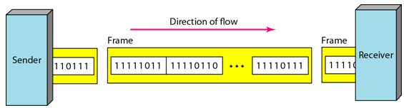
Synchronous Transmission
In synchronous transmission, we send bits one after another without start or stop bits or gaps. It is the responsibility of the receiver to group the bits.

Slide 11
Synchronous Transmission
Timing becomes very important, therefore, because the accuracy of the received information is completely dependent on the ability of the receiving device to keep an accurate count of the bits as they come in.
The advantage of synchronous transmission is speed. With no extra bits or gaps, synchronous transmission is faster than asynchronous transmission.
For this reason, it is more useful for high-speed applications such as the transmission of data from one computer to another. Byte synchronization is accomplished in the data link layer.

Slide 12
Question
Compare synchronous and asynchronous data transmission technique.

